Slide 1
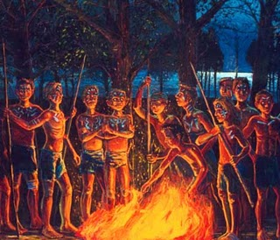
.
LORD OF THE FLIES
Symbolic Beginnings
Chapters 1-3 Review

Slide 2
Subordinate Characters
Subordinate Characters: are involved in the plot have little influence.
React to events; They do not cause them.
Add realism to the story
In Allegorical novels they are used as a representative tool.
Simple Motivation and Conflicts

Slide 3
Main Characters
Main Characters: the plot revolves around their actions.
They experience and change of Evolution.
They change other characters.
Complex Motivation and Conflicts

Slide 4
Literary Terms
Symbolism – A symbol is a character, place, thing or event that stands for something else, often an abstract idea.
A symbol can be anything that could represent a larger idea.

Slide 5
Literary Terms
Symbolism – A symbol is a character, place, thing or event that stands for something else, often an abstract idea.
A symbol can be anything that could represent a larger idea.

Slide 6
What does this represent?
FREEDOM LIBERTY

Slide 7
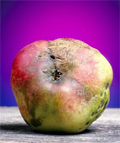
A Symbol can be an item
Because the Fall of Roman was not from an outside source, instead Roman’s eventual fall from power came from the corruption within.
A rotting apple often times is considered a Symbol of the Roman empire

Slide 8
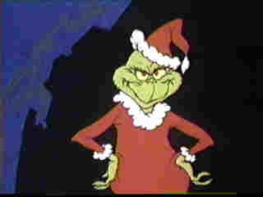
A symbol can be a character
The Grinch represents negative attitude toward Christmas or any celebration.

Slide 9
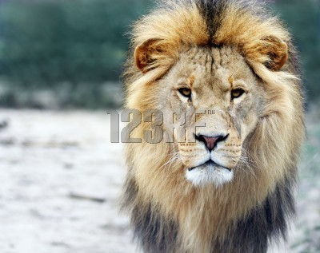
What do these symbolize?

Slide 10
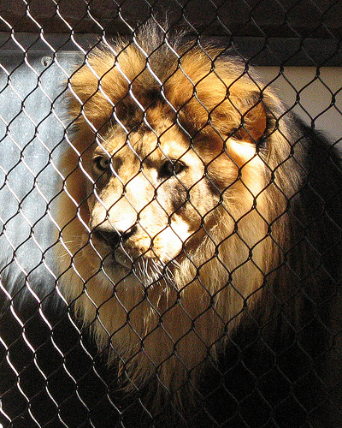
Often times combinations can be symbolic

Slide 11
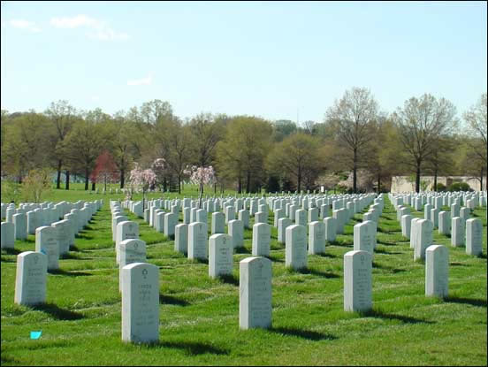
A Symbol can be a place

Slide 12
A symbol can be an event
Runner crossing the finish line could represent success, perseverance, accomplishing a goal.

Slide 13
New Term: Allegory
A story with two or more levels of meaning.
Literal level- what is literally stated
Symbolic level- represents ideas
An Allegory must have Symbols.

Slide 14
Plot
Characters
Patterns of events
Statements / Actions
THEME
Abstract Idea
Represented by a SYMBOL

Slide 15
Group Symbolic Exercise

Slide 16
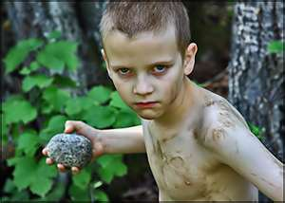
Characters / Objects
The Island
The conch
Ralph
Piggy
Jack Merridew
The Choir
The Snake thing / beastie
Piggy’s Glasses
Signal Fire

Slide 17
Quotes and Actions
Ralph plays in the beach naked
Garden of Eden
Appearance of Jack and his choir.

Slide 18
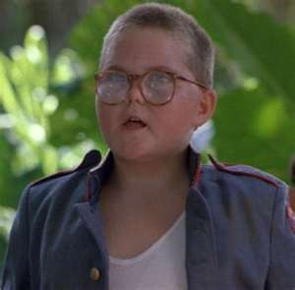
Quotes and Actions
“this belongs to us.“ – Ralph looking at the island
Ralph’s mockery of Piggy
Jack attempting to kill the pig.

Slide 19
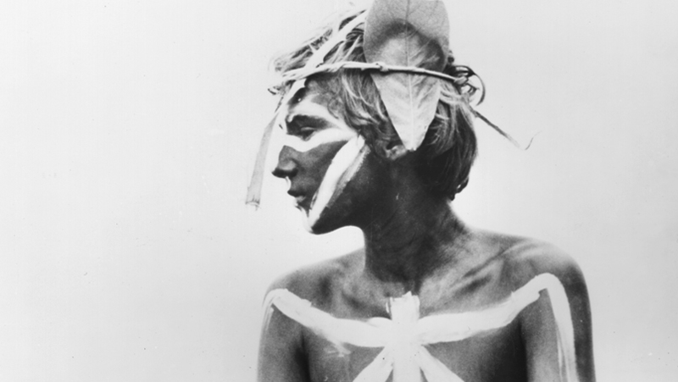
Themes and Concepts
Miniature Society
Social hierarchy
Clash in human nature between instinctual and learned behavior.

Slide 20
Themes and Concepts
Boys have no society, no rules, and no concerns beyond personal survival.
Choice between returning to a pre-civilized state of humanity and re-imposing social order
The impulse towards savagery and the need for civilization

Slide 21
Themes and Concepts
Ralph is the antithesis of Jack
The vote for chief
Emphasis on the boys' childishness

Slide 22
Themes and Concepts
Ralph is the antithesis of Jack
Loss of Innocence
Development of innate desires and urges
“something growing but not sure from where”

Slide 23
Vocab Review
Specious
Skewed
Bastion
Hiatus
Gesticulated
Ebullience

Slide 24
Quiz Monday

Slide 25
Subordinate Characters
Subordinate Characters: are involved in the plot have little influence.
React to events; They do not cause them.
Add realism to the story
In Allegorical novels they are used as a representative tool.
Simple Motivation and Conflicts

Slide 26
Main Characters
Main Characters: the plot revolves around their actions.
They experience and change of Evolution.
They change other characters.
Complex Motivation and Conflicts

Slide 27
Inferences
Practice Inference Skill.

Slide 28
What is the Inference?
Page 7 :
“The undergrowth…..Home counties?
Page 7:
“ Where’s the man with the mega phone?” The fair boy shook his head.
Page 8:
“Aren’t there any grownups at all” …”No gownups?

Slide 29
What is the Inference?
Page 10: Second Paragraph
“He jumped…….and the water”
What could be the symbolism?

Slide 30
What is the Inference?
Page 10: Third Paragraph
“He was old enough…..no devil”
What could be the symbolism?

Slide 31
What is the Inference?
Page 10: Ralph and Piggy Conversation
“What’s your father…..As many as I liked”
What does this tell passage us about Piggy?

Slide 32
What is the Inference?
Page 19: Ralph sees the choir boys.
Bottom Paragraph “ Within…..”
What symbolic element could this description of the boys represent?

Slide 33
What is the Inference?
Page 20. Description of Jack
Third Paragraph “ Inside the floating cloak…”
What insight could this give into this character?

Slide 34
What is the Inference?
Page 20 and 21. Piggy’s view of Jack Merridew
Bottom of the page and onto page 21
What could Piggy’s reaction to Jack foreshadow?

Slide 35
What is the Inference?
Page 21. Laughing at Piggy
“Shut up Fatty”…..
What does this action represent?

Slide 36
What is the Inference?
Page 22 Description of Ralph Vote for Chief
Bottom of the page “But there was a stillness….”
Page 23 First Paragraph
Jack’s face disappeared…..
What does this vote represent? Foreshadow?

Slide 37
What is the Inference?
Page 28 Pushing the Rock
“The great rock…”
What does this tell you about the nature of he boys?

Slide 38
What is the Inference?
End of Chapter 1
Page 31
What does this foreshadow?

Slide 39
What is the Inference?
End of Chapter 2
Page 46-47
What is happening?

Slide 40
What’s the inference
Page 53
Jack talking about Rescue
“Rescue? Yes, of course.”
What is Jack priority?

Slide 41
What’s the inference
The conversation between Jack and Ralph on Page 51
What does this imply?

Slide 42
What’s the inference
The end of Chapter 3
Simon’s Character

Slide 43
Vocab Review
Specious
Skewed
Bastion
Hiatus
Gesticulated
Ebullience

